Slide 1
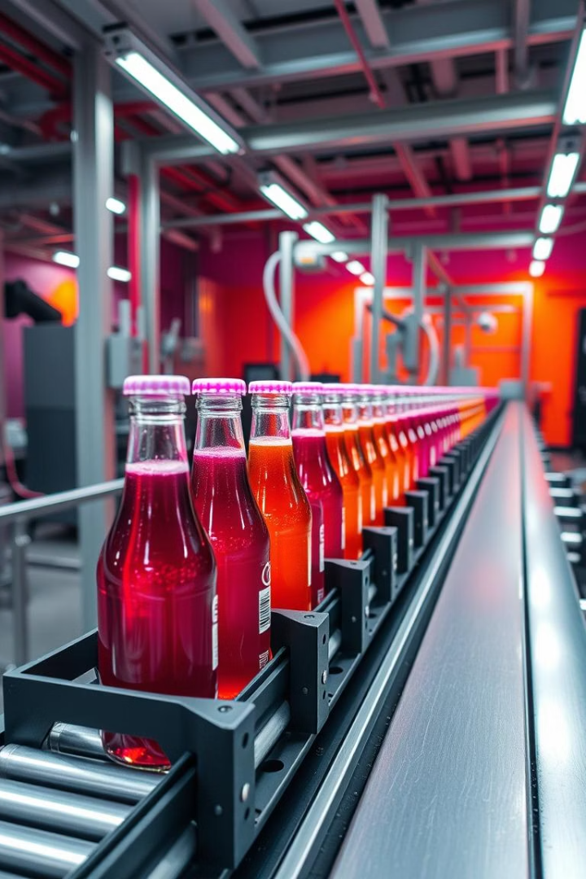

Beverage Production Analysis
This analysis examines production efficiency, operator performance, and downtime factors across our beverage manufacturing operations.
by. Zeinab A.Rehim & Hassan Mohammed

Slide 2
Cleaning Process applied for line productivity table
Remove column 7 ( has null value in all its cells)
Add column to calculate difference between start and end time
Same column calculate the duration of each row value then change data type to duration.
Add column to calculate duration in total minutes, renamed as total minutes and set data type automatically to decimal. This is actual batch time
Change data type of start time and end time columns to time instead of date.

Slide 3
Cleaning Process applied for line downtime table
Use first row as a header
Unpivot factors column

Slide 4
DAX Process
Calculate total downtime for each factor and for each batch
Calculate the difference between Actual time and estimated time

Slide 5
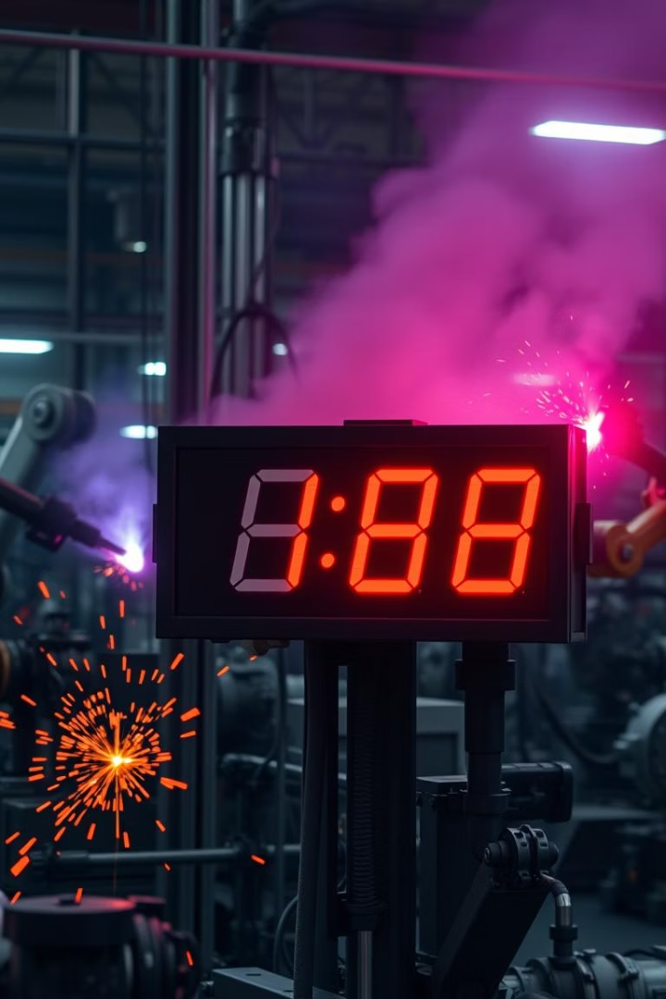
Production Time by Product
900
88
Total Minutes
Minutes Per Batch
CO-600 (Cola) across 15 batches
LE-600 has fastest average batch time
89
Minutes Per Batch
DC-600 follows closely behind

Slide 6
Operator Productivity
Dee
Charlie
Lowest average batch time at 94 minutes
Produced the most batches (11)
Most efficient operator by time
Highest productivity by quantity

Slide 7






Product Analysis
Lemon Lime (LE-600)
Fastest production at 88 minutes per batch
Cola (CO-600)
Orange (OR-600)
Most produced flavor with 15 total batches
Least downtime impact with only 75 minutes recorded

Slide 8
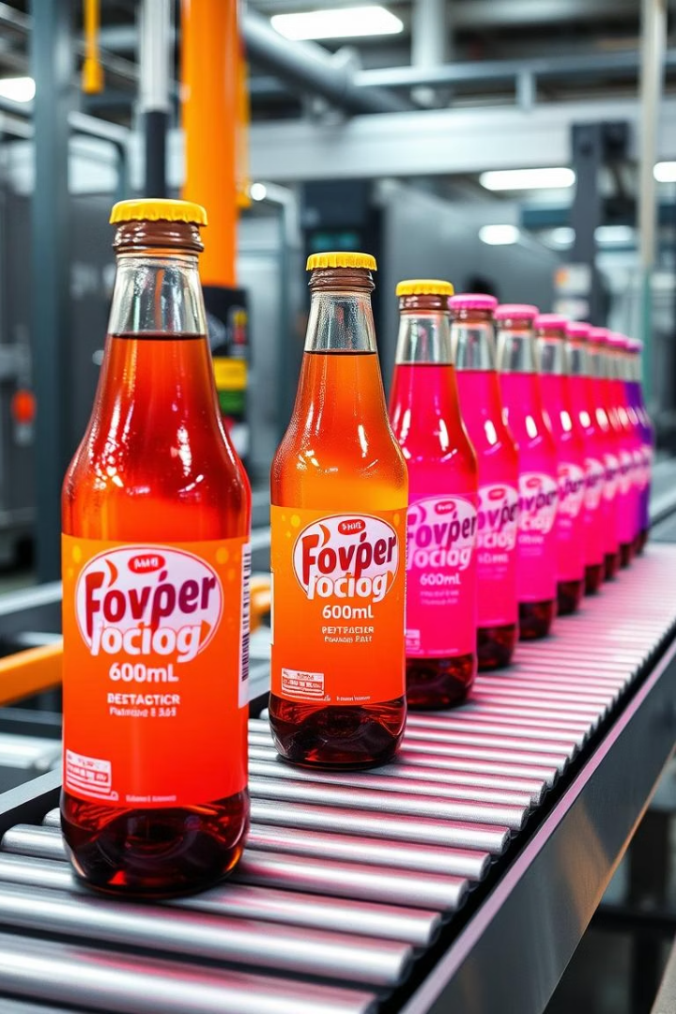
Package Size Efficiency
600ml Packages
Lemon Lime (600ml)
Shortest production times per batch
Most efficient at just 88 minutes average per batch
Size Impact
Smaller packages generally require less production time

Slide 9
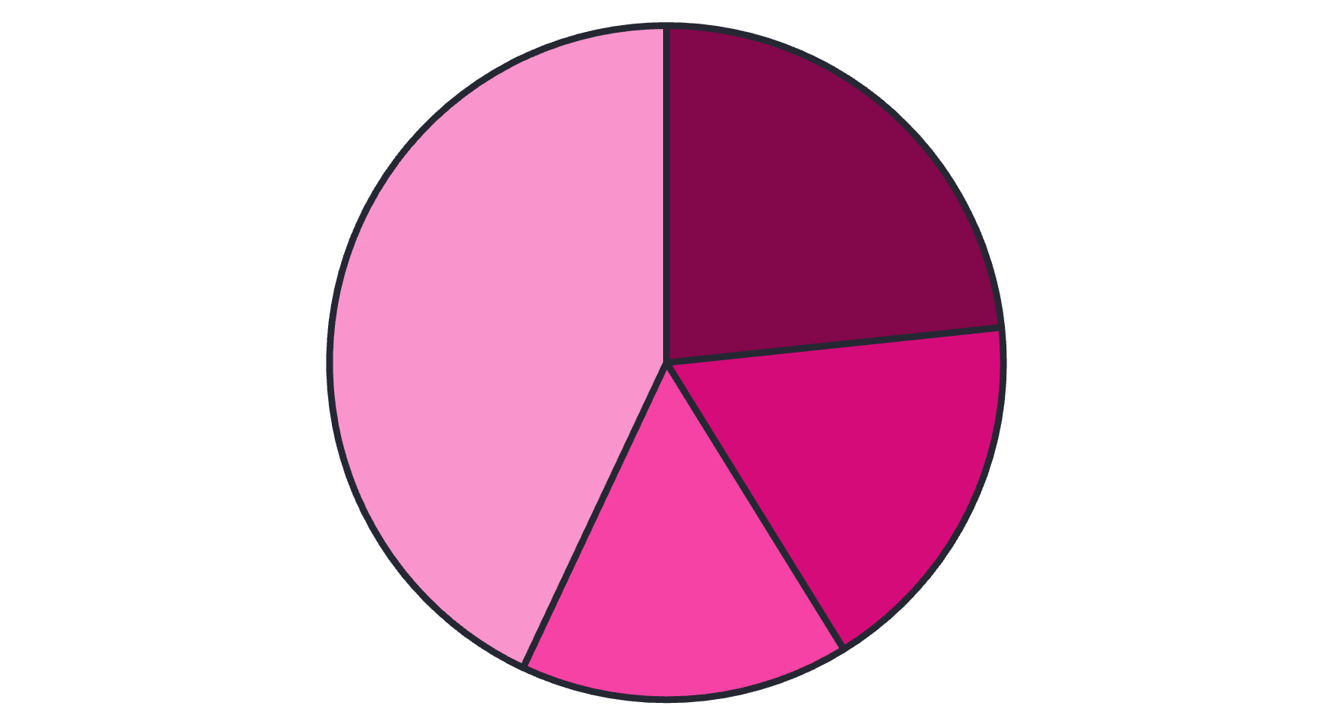
Downtime Analysis
Machine Adjustment
Machine Failure
Inventory Shortages
Operator Errors

Slide 10




Operator vs. Non-Human Errors
Operator Errors
Machine Factors
Inventory Issues
Responsible for 44.09% of total downtime
Machine adjustment (23.92%) and failure (18.30%) combined
Inventory shortages account for 16.21% of downtime

Slide 11



Critical Batch Analysis
Batch 422147
Encountered significant downtime of 107 minutes
Root Cause Analysis
Requires investigation into specific factors
Preventative Measures
Develop protocols to avoid similar issues

